Slide 1

Feeling safe

Slide 2
Do you FEEL SAFE?
•Everyone has the right to be safe and feel safe in and out of college.
Please tell us if you don’t feel safe. You may feel comfortable:
•Emailing the Feelsafe team at learnerfeelsafeteam@cavc.ac.uk
•Phoning 029 20250420
•Speaking to a Wellbeing Officer at one of our Hubs
•Telling your tutor
•Speaking to a parent or trusted adult who can contact us
It is your safeguarding responsibility to report if you are concerned that someone is in danger of immediate risk.

Slide 3


‘Respect’

Slide 4



Activity 1
What does ‘Respect’ mean?

Slide 5
What does ‘Disrespect’ mean?

Slide 6
Activity 2 ~ What does Respect ....
Look like ?
Sound like ?
Feel like ?

Slide 7
Activity 3
Why is it important to behave respectfully?

Slide 8
Activity 5
What do we treat people with respect?

Slide 9
Activity 4
What kind of behaviour is disrespectful?

Slide 10
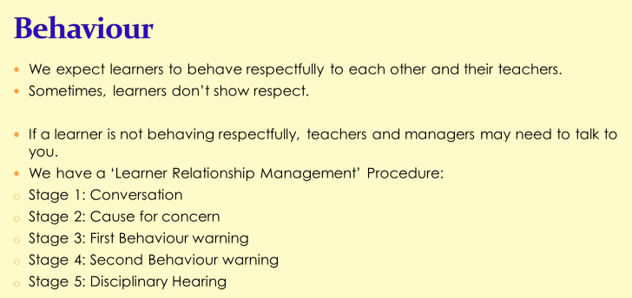

Slide 11
